Slide 1
OPERATING SYSTEMS (CS F372) File System
Barsha Mitra
CSIS Dept., BITS Pilani, Hyderabad Campus

Slide 2
File Attributes
Name
Identifier – unique tag (number)/token identifies file within file system, non-human-readable
Type
Location – pointer to file location on device
Size – current file size
Protection – controls who can do reading, writing, executing
Time, date, and user identification – data for protection, security, and usage monitoring
Information about files are kept in directory structure maintained on the disk
Directory entry – name and identifier

Slide 3
File Operations
System calls for file operations
Create
Write – at write pointer location
Read – at read pointer location
Reposition within file - seek
Delete
Truncate
Append
Rename
OS maintains an open-file table
For a requested file operation, file is specified via an index into the table
When file is closed, OS removes entry from file table

Slide 4
File Types

Slide 5
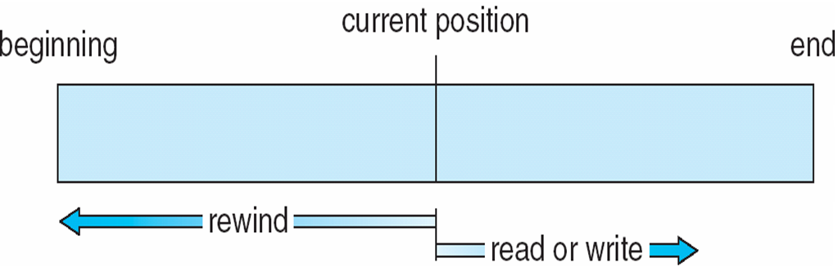
Access Methods
Sequential Access
read_next()
write_next()
reset()
Direct Access/Relative Access – file consists of fixed length logical records
read(n)
write(n)
position_file(n)
n = relative block number w.r.t beginning of file

Slide 6
Directory
The directory is organized logically to obtain
Efficiency – locating a file quickly
Naming – convenient to users
Two users can have same name for different files
The same file can have several different names
Grouping – logical grouping of files by properties
Directory Operations
Search for a file
Create a file
Delete a file
List a directory
Rename a file
Traverse the file system

Slide 7
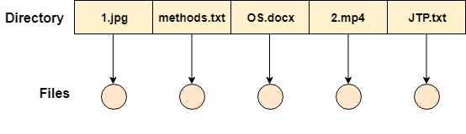
Single-Level Directory
A single directory for all users
Entire system will contain only one directory which is supposed to mention all the files present in the file system
Directory contains one entry for each file present on the file system
Naming problem
Grouping problem

Slide 8
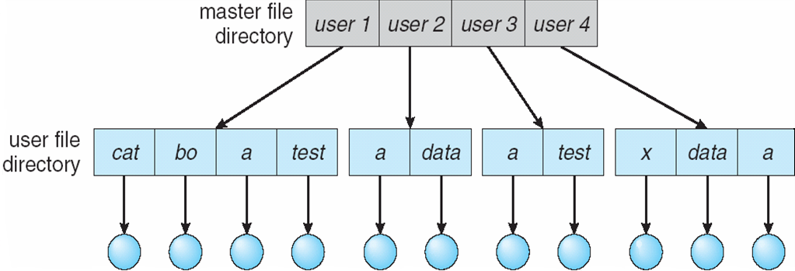
Two-Level Directory
Separate directory for each user
User name and file name define a path
MFD is indexed by user name/ account number
Can have the same file name for different user
Efficient searching, only UFD is searched for creation or deletion
Creation and deletion of user directories – admin
Sharing not possible

Slide 9
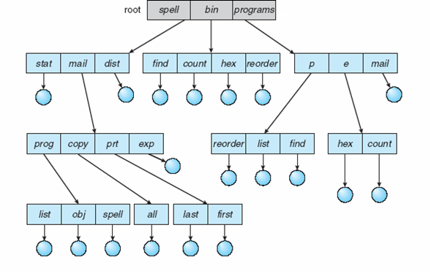
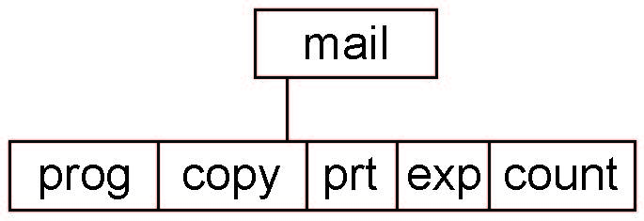
Tree-Structured Directory
Efficient searching
Directory is a special file
Current directory (working directory)
cd /spell/mail/prog
Creating a new file is done in current directory
Delete a file - rm <file-name>
Creating a new subdirectory is done in current directory
mkdir <dir-name>
With permissions, one user can access another’s files
Deleting “mail” ⇒ deleting the entire subtree rooted by “mail”

Slide 10
Tree-Structured Directory
Absolute path name – root/spell/mail/copy/all
If you are in inside root/spell/mail, then
relative path name for all is copy/all

Slide 11
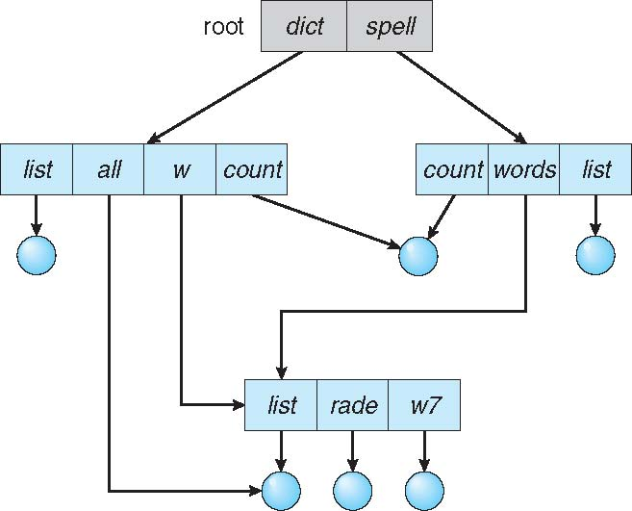
Acyclic-Graph Directory
Have shared subdirectories and files
Two different names
Dangling pointer

Slide 12
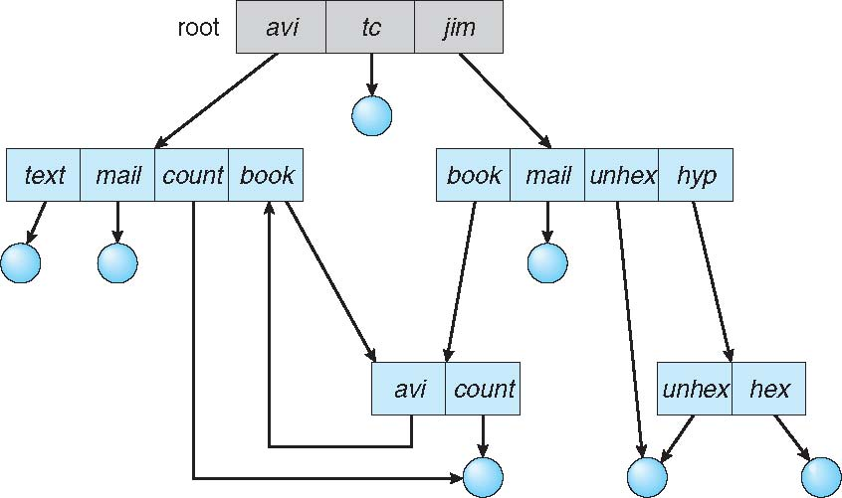
General Graph Directory
How do we guarantee no cycles?
Allow only links to file not subdirectories
Garbage collection - mechanism to determine when the last of the references of a file has been deleted and the disk space can be reallocated
Every time a new link is added use a cycle detection algorithm to determine whether it is OK

Slide 13
Thank You

